Slide 1
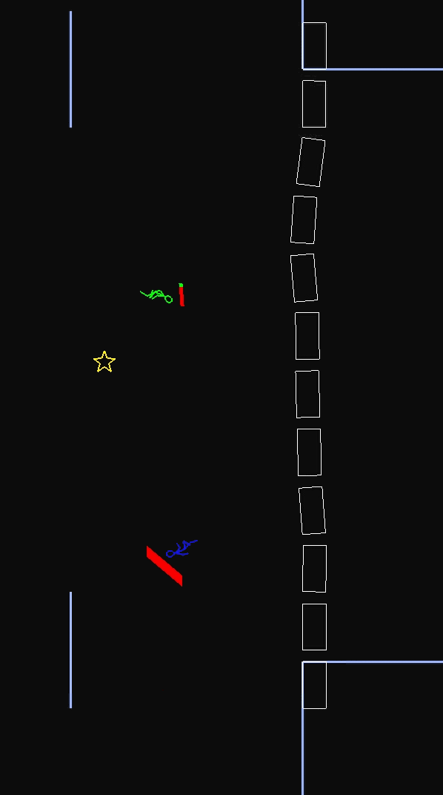
Rhabarber ‒ Multiplayer Game
Score by catching Treasures
Shared Gravity
OpenGL
Emini Physics Engine
Game Server and Thin Clients
TCP Connections for Data Transfer
UDP Multicast to advertise Server

